Slide 1
Code, Craft, Community SANS Holiday Hack Challenge
2023

Slide 2
The Objective
Have fun playing games with friends
Be Creative
Challenge Yourself
Learning About Security
Think about how systems can be misused / abused
Think about how the systems you build can be misused / abused

Slide 3
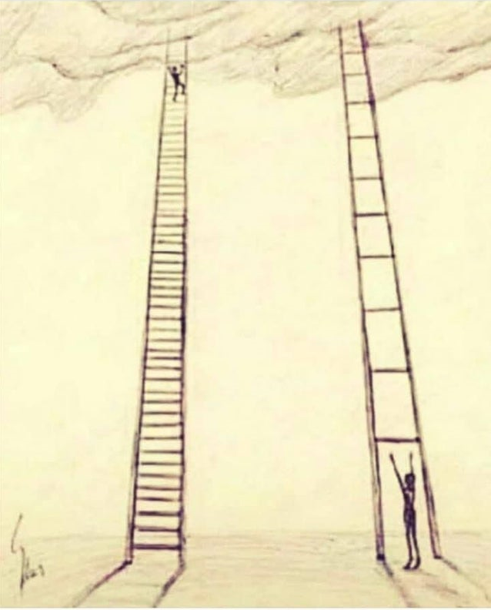
The Importance of Smaller Steps
Notes:
Security seems daunting at first.
But It’s similar skill set to development with a few twists and turns
Perspective Change - Rather than how do you do something, it’s how do you abuse something
How do we get started?

Slide 4
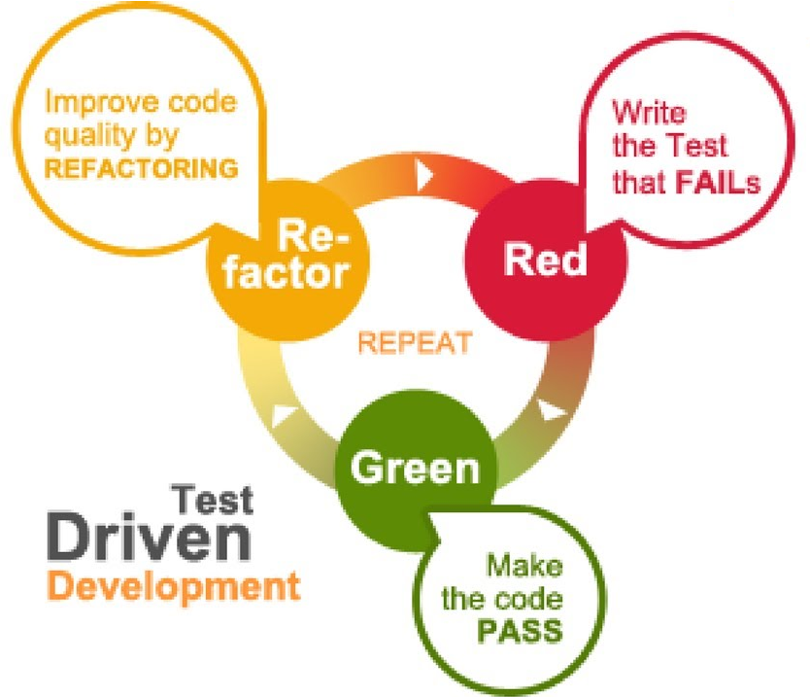
TDD Process
Blatantly stolen from What is TDD (Test Driven Development)? | How to do TDD? | Red Green Refactor
https://www.youtube.com/watch?v=T38L7A0xP-c
Notes:
We are used to circular processes. TDD for example

Slide 5
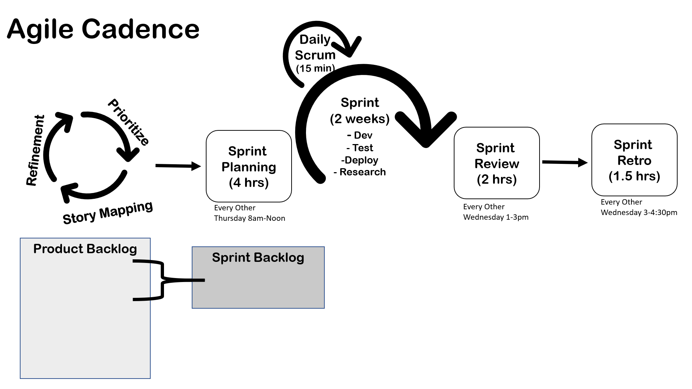
Agile Process
Notes:
Agile Cadences – Another Example
Integrating Feedback as we go

Slide 6
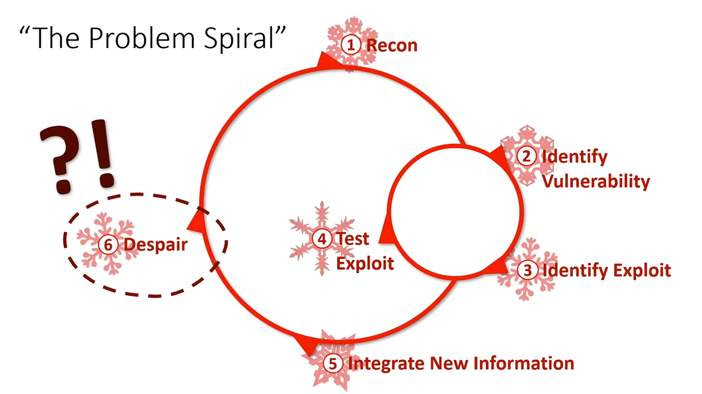
Hacking Process
Blatantly stolen from Katie Knowles, How to (Holiday) Hack It: Tips for Crushing CTFs & Pwning Pentests | KringleCon 2019
https://www.youtube.com/watch?v=c02mH7F1xvU
Notes:
Situational Awareness
Understand the Problem
Reconnaissance
Playing Around
Use the system as it’s intended to be used
Devise a Plan
Use previous experience
Google
Carry out the Plan
Take notes
Capture new information
Learn something new, go back to situational awareness / devise a plan
Look Back at Notes

Slide 7
The Disclaimer
Be smart, use this information conscientiously to understand and improve security, and to put the ethical into Ethical Hacker!
The information learned today MUST ONLY be used on property YOU OWN.
Using these techniques on your friend’s computer, your neighbor’s door lock, your client’s website, and most other situations is generally illegal without explicit written consent.

Slide 8
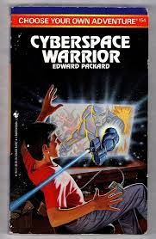
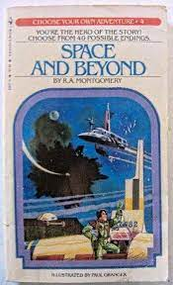
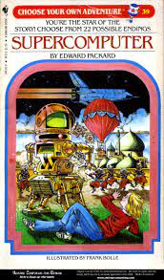
The Exercise(s)
Notes:
Choose you own adventure

Slide 9
Challenge #1 - Combination Lock
Location: Steampunk Island - Brass Bouy Port
Talk to: Bow Ninecandle
Skill: Understand how to defeat Master lock combination locks
How To Open A Dial Combination Lock
Close Up On How To Decode A Dial Combination Lock In 8 Attempts Or Less
https://docs.google.com/document/d/1QhKZLDr22G0RpuTSGm0M6pz4dG82IByesim3elwfw98/edit
Addition Challenges:
Write code to generate possible lock combinations
Try your hand at lock sports with physical Master Combination locks or padlocks
Try the Luggage Lock Decode challenge
Location: Island of Misfit Toys – Squarewheel Yard
Talk To: Garland Candlesticks

Slide 10
Challenge #2 – Snowball Fight
Location: Christmas Island - Frosty's Beach, left past the sponsor booths
Talk to: Morcel Nougat
Skill: JavaScript, reading code, browser reconnaissance
Addition Challenges:
Beat the game in single player mode
Challenge #4 – Na’an
Elf Hunt – Piney Sappington – Pixel Island - Rainraster Cliffs

Slide 11
Challenge #3 – Learn Something New
Azure 101
Location: Christmas Island – Rudolph’s Rest, left bottom corner of island
Talk to: Sparkle Redberry
Skill: Azure CLI, Cloud reconnaissance
Linux 101
Location: Christmas Island – Frosty’s Beach, left past sponsor booths
Talk to: Ginger Breddle
Skill: Linux command line, Linux tools

Slide 12
Challenge #4 – Na’an
Location: Film Noir Island
Talk to: Shifty McShuffles
Skill: JavaScript, code reading, blind attacks, server side attacks, technology enumeration

Slide 13
Challenge #5 – Hashcat
Location: Island of Misfit Toys - Scaredy-Kite Heights
Talk to: Eve Snowshoes
Skill: Recover / Crack a password

Slide 14
The Logistics
https://2023.holidayhackchallenge.com/
Create an Account
Choose one or more challenges
Feel free to use AI tools (SANS required using them this year)
Some challenges may be helpful to have more than one person logged in
Small Teams of 3-4

Slide 15
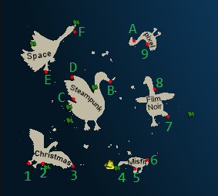
The Map
Christmas Island
1 - Orientation
2 - Frosty's Beach
3 - Rudolph's Rest
Island of Misfit Toys
4 – Scaredy Kite Heights
5 - Tarnished Trove
6 - Squarewheel Yard
Film Noir
7 - Chiaroscuro City
8 - The Blacklight District
Pixel Island
9 - Rainraster Cliffs
A - Driftbit Grotto
Steampunk Island
B - Brass Bouy Port
C - Rusty Quay
D - Coggoggle Marina
Space Island
E - Spaceport Point
F - Cape Cosmic

Slide 16
Quick Tour of UI
A Quick Tour
Music
Badge (Hints, Items, Objectives, Narrative)
Teleport?
Orientation Challenge
Notes:
Challenge #1 – Swirl
Quickly show this solved
Get hints by talking to dude
Show hints in badge
Start Challenge
Challenge #2 – Unescape Tmux
Show hints
Show Challenge
If you know answer let other try first
Ask group to solve together
Demo iframes & source code

Slide 17

How did it go? What did you learn? What challenged you?

